Slide 1
John Wycliffe Primary School
Year 2 SATs meeting

Slide 2
Year 2 staff:
Class Teachers: Mrs Horton, Mrs Beck, Mrs Davinson, Miss Williams
Teaching assistants:Mrs Gamble, Mr Watts, Mrs Bolderston

Slide 3
Aims:
To inform parents about SATs
G

Slide 4
This is the third year in which children in Year 2 have been assessed against the updated curriculum.
The current curriculum is more rigorous and places a greater emphasis on key skills such as grammar, punctuation and spelling
S

Slide 5
FAQs
What are SATs?
What happens at the end of Key Stage 1?
When will the tests happen?
How will my child be prepared for them?
S

Slide 6
Key stage 1 SATs (Statutory Assessment Tests)
Mathematics Paper 1: Arithmetic
Mathematics Paper 2: Reasoning
English Reading Paper 1: Combined reading prompt and answer booklet
English Reading Paper 2: Separate reading booklet and answer booklet
English Grammar, Punctuation and Spelling Paper 1: Spelling
English Grammar, Punctuation and Spelling Paper 2: Grammar and Punctuation questions
Children’s writing is assessed by the teacher using evidence of progress in writing throughout the year. There is no formal written test.
G

Slide 7
Mathematics
Teacher assessment, not test results, will have the final say in your child’s overall results for the end of KS1.
Areas of Mathematics:
Number
Measurement
Geometry
Statistics
At the end of KS1, children are assessed against the following criteria:
Working towards the expected standard
Working at the expected standard
Working at a greater depth within the expected standard
S

Slide 8


Test Papers
Arithmetic
Reasoning
S

Slide 9
Arithmetic
Number questions based on addition, subtraction, multiplication, division and fractions.
Children should use the methods taught in school
The questions get progressively harder.
G

Slide 10
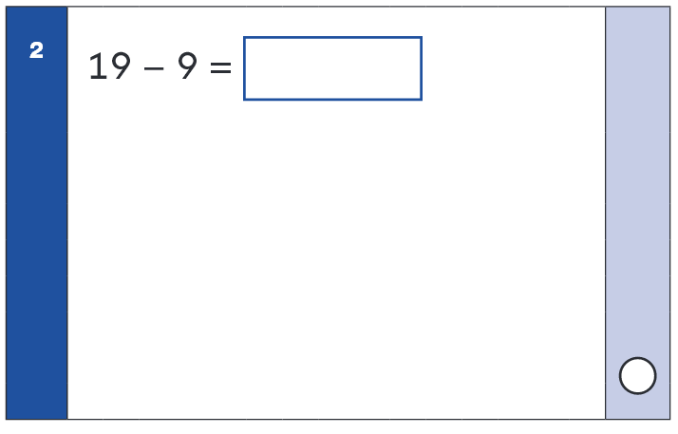
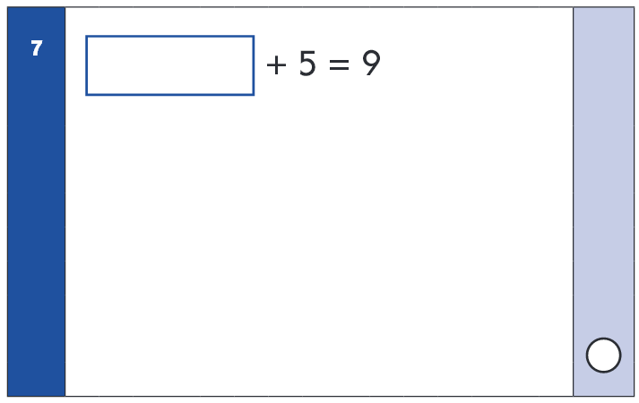
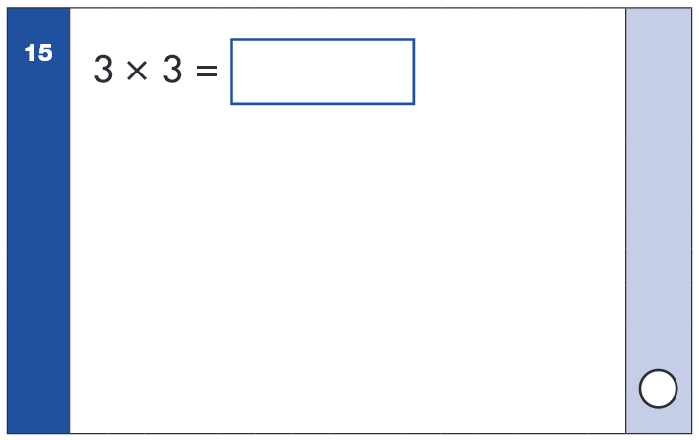
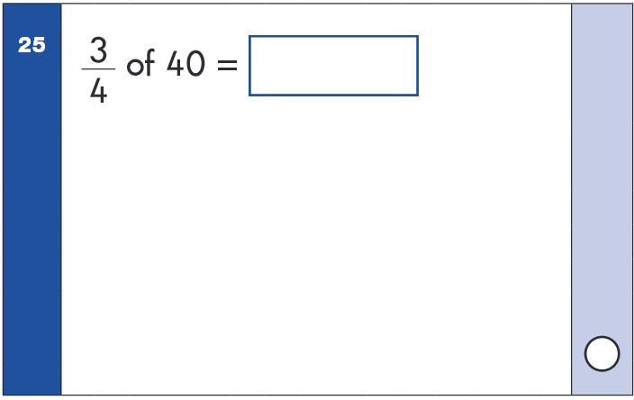
Examples
S

Slide 11

Reasoning paper
Includes both mental/oral and reading/writing questions.
Children answer questions based on their knowledge of number, measure, geometry and statistics.
Most questions have a real-life context and will require children to choose the method they want to solve it.
G

Slide 12
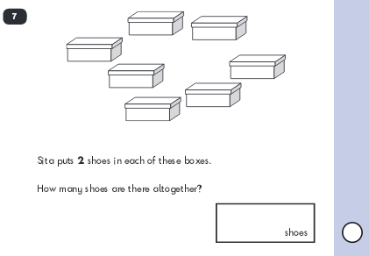
Examples
S

Slide 13
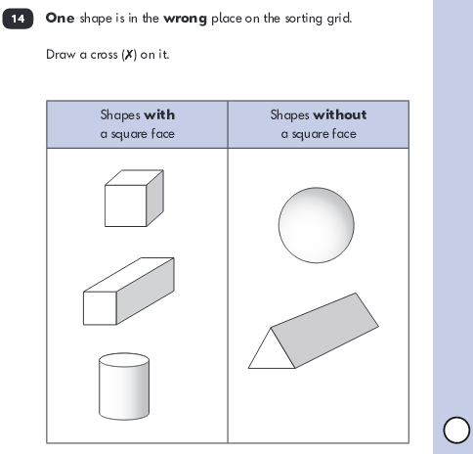
S

Slide 14

Reading assessment
Teacher assessment, not test results, will have the final
say in your child’s overall results for the end of KS1.
An overall judgement will be given on both the speed and accuracy of children’s reading and how they respond to what they have read
At the end of KS1, children are assessed against the following criteria:
Working towards the expected standard
Working at the expected standard
Working at a greater depth within the expected standard
G

Slide 15
Reading Paper 1: Combined reading prompt and answer booklet
Children will be given a text to read and questions to answer
Each page will have some text and some questions
Children will be required to recall information and record an answer either in writing or by choosing from a multiple choice list.
G

Slide 16
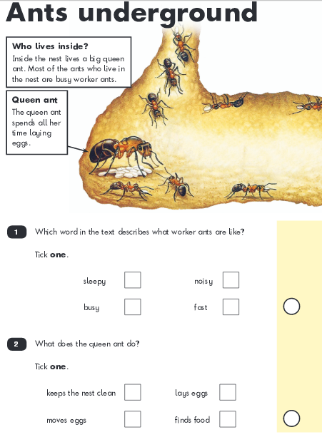
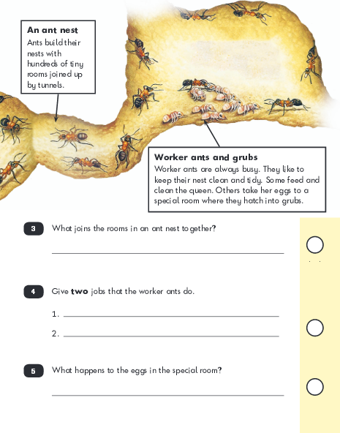
Examples
S

Slide 17
Reading Paper 2: Separate reading and answer booklet
Children will be given a longer text text to read and a separate booklet with questions
The text is longer and more challenging. The questions require children to infer meaning from the text, give opinions and explain their reasoning.
G

Slide 18
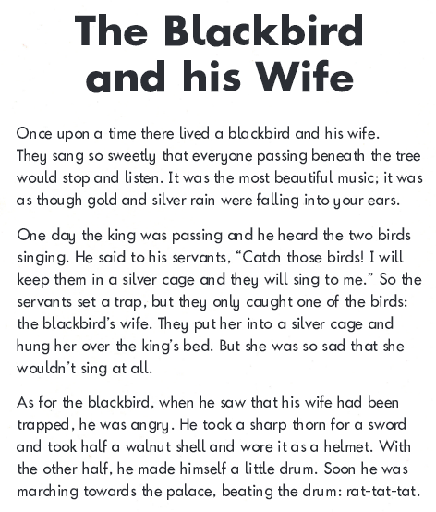
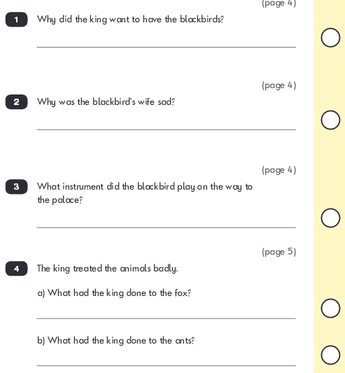
Examples
S

Slide 19
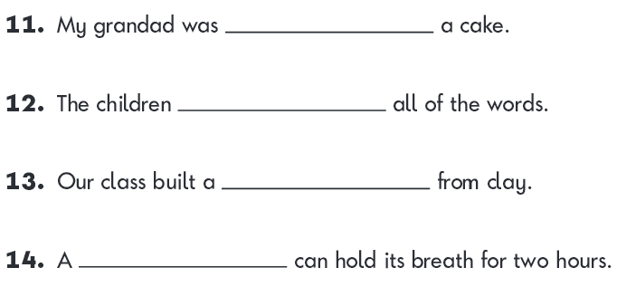
English Grammar, Punctuation & Spelling
Paper 1: Spelling
The teacher reads sentences and the children fill in the missing word with the correct spelling.
G

Slide 20
Optional-English Grammar, Punctuation and Spelling Paper 2: Questions
Children are tested against the grammar, punctuation and spelling criteria for Year 2. The test outcome forms part of the teacher judgement towards the overall writing assessment
Questions will be in the form of short written answers or multiple choice answers
Children have been taught and should be familiar with the key vocabulary e.g. noun phrases, suffixes etc
G
G

Slide 21
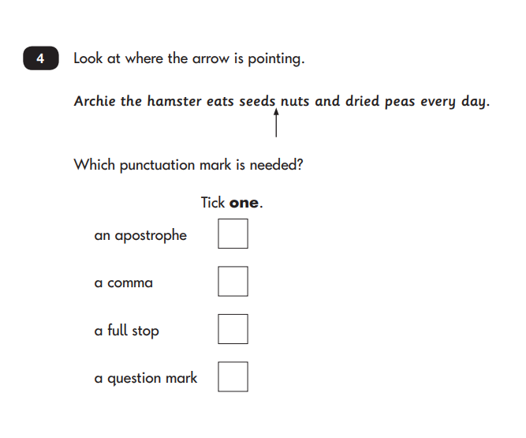
Examples
S

Slide 22
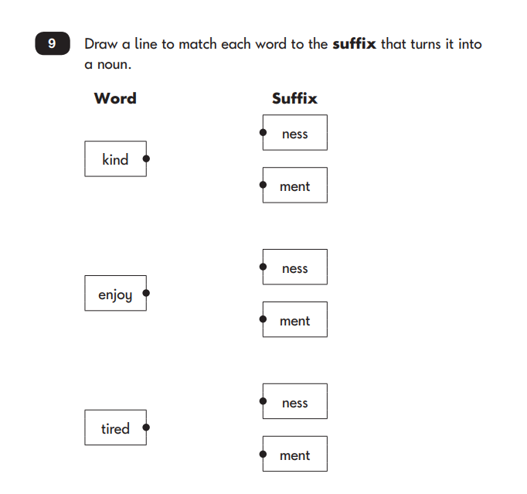
Examples
S

Slide 23
How can I help?
Reading – Continue to read with your child every day. Ask questions about what they read.Retell the story. Help them to find texts that they enjoy reading.
Writing – Help your child with their homework. Remind them to use their best handwriting at all times. Ask them to read what they have written to you. Correct their spoken grammar. Play on Spelling Shed.
Maths – Ask them to talk about their current learning in Maths and what they need support with. Play practical, written and online games to encourage a love of Maths.
S

Slide 24
Useful Links
BBC KS1 Bitesize
Woodlands Grammar and Punctuation
Teachit
Grammar Book
Maths Is Fun
https://www.gov.uk/government/collections/national-curriculum-assessments-practice-materials#key-stage-1-past-papers
Remind children to also use their LGFL (London Grid for Learning)
USO, which they can use at home to access learning resources
G

Slide 25

A few reminders
Reading
Homework/Spelling
PE kits
Healthy lunch and breakfast
Medication
Water bottle
Book bags
S

Slide 26
Thank you
Any questions?
S

Slide 27
G

